Slide 1

Retail Challenge Customer Segmentation and Forecasting

Slide 2

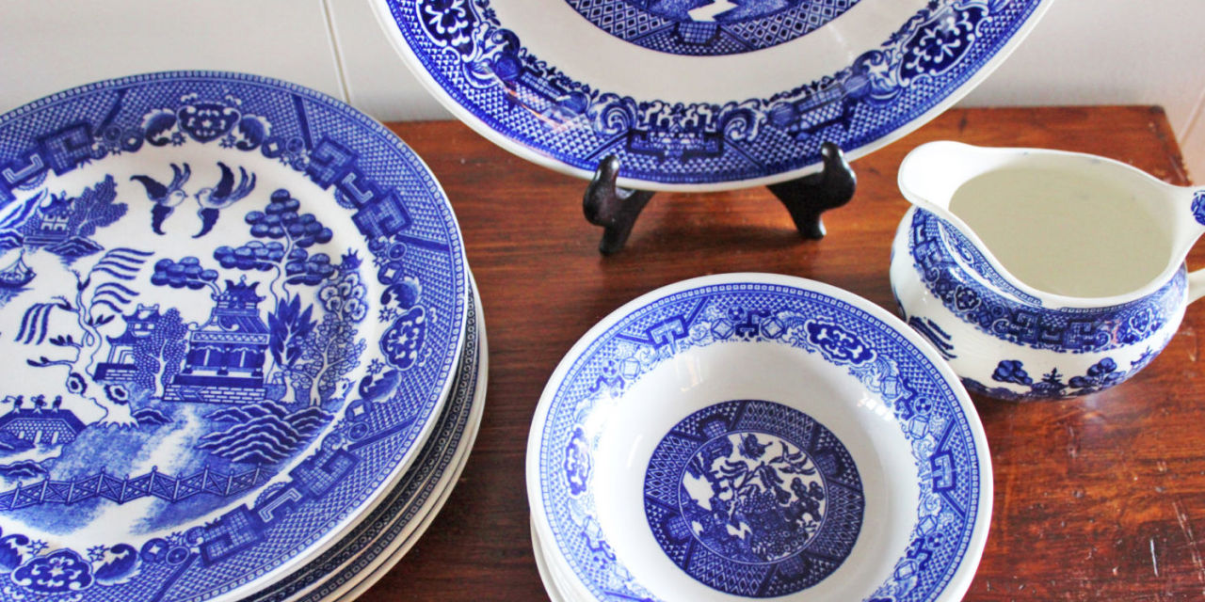
Overview
A retail business specializing in household items.
Based in the UK, also transacting internationally.
All transaction data from end of 2009, all of 2010 and 2011 till early December.
Wish to understand customer behaviour, possible segments, and future forecasts.
Image src: https://clv.h-cdn.co/assets/17/20/1280x640

Slide 3

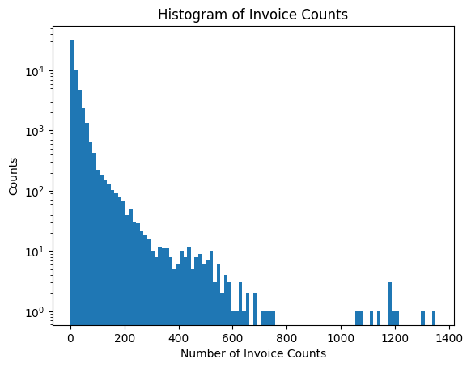
Data Section - EDA
Most invoices have one transaction, some have over a 1000.
~2% of all invoices were cancellations
Cancellations are also entered as a row with negative quantity for items and price.
~0.5% of all invoices were returns.

Slide 4

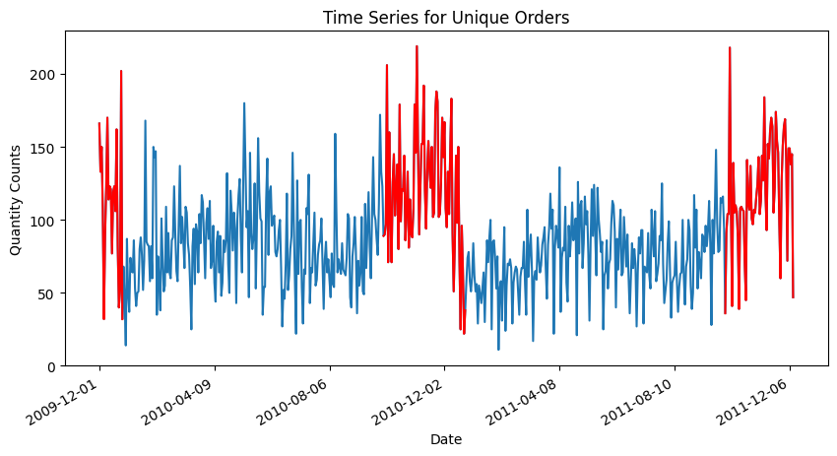
Data Section - EDA Continued
Holiday months for Oct, Nov, and Dec (shown in red) do show higher number of invoices.
~90% of all invoices were for transactions within the UK.
The business isn’t open all days, so some days have zero transactions.

Slide 5

Data Section – Data Quality
Data contains mixed transaction types; this can be problematic.
Ex: StockCode: TEST001, AmazonBill payments added as a transaction row,
Some transactions are missing Customer ID values, they are stored as ‘nan’.
Not all StockCode values are 5-digit integers.
Significant orders and cancellations made within minutes.

Slide 6

Data Section - Preprocessing
Clean up the data based on data quality findings.
Group by customers and generate additional features from the data:
- Number of cancellations or returns for a customer.
- If the customer transacted during the holidays.
- If the customer is an international customer, has had international orders.
- Total transaction amount based on customer profile.

Slide 7

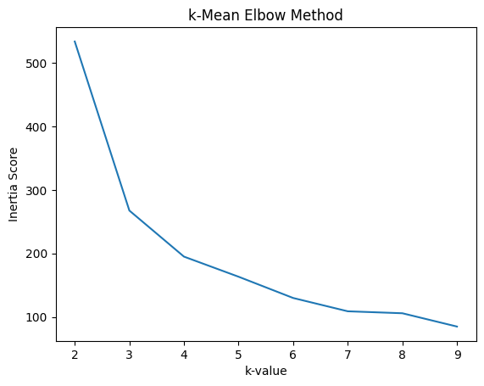
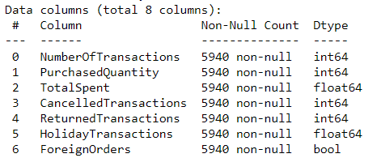
Model Section - Clustering
Used aggregated data for customers, along with generated features.
Preprocessing for normalization, passed through k-values between 2-10.
Went with a k-value of 4 to compute the clusters.

Slide 8

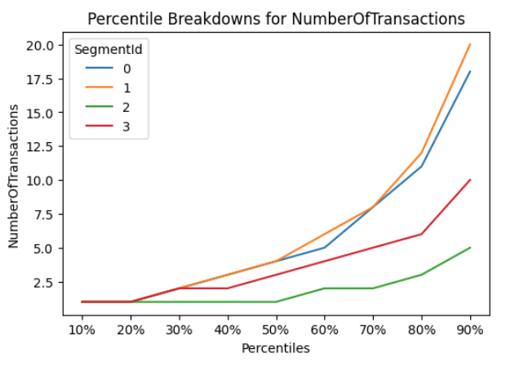
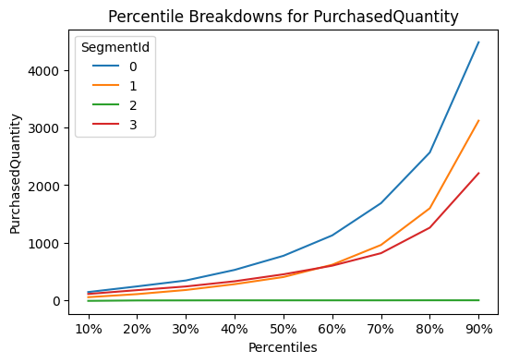
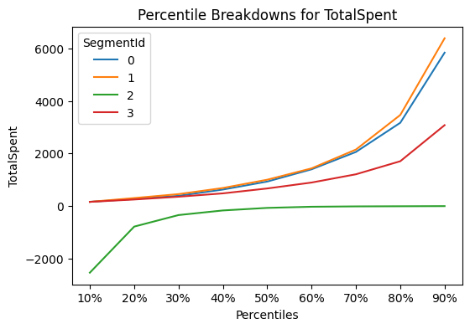
Model Section – Cluster Descriptions

Slide 9

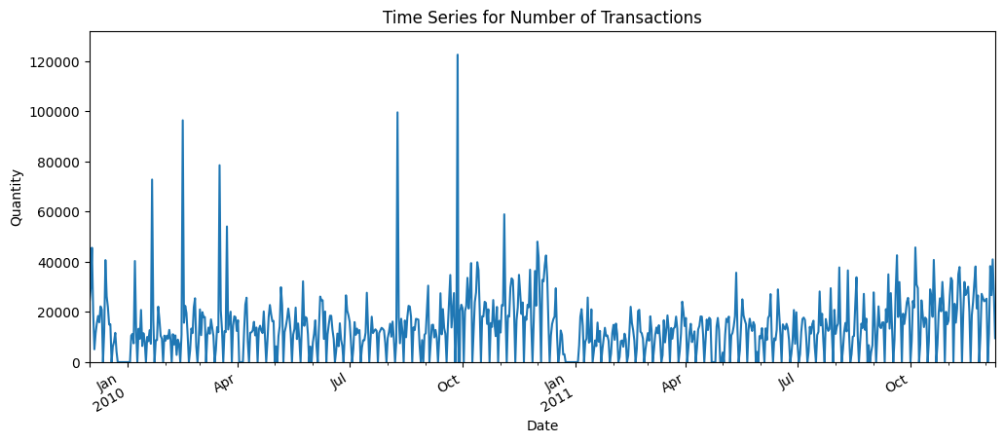
Model Section - Forecasting
Reindexed the dates all existing values.
Clear pattern of missing transactions during weekend and Christmas.

Slide 10

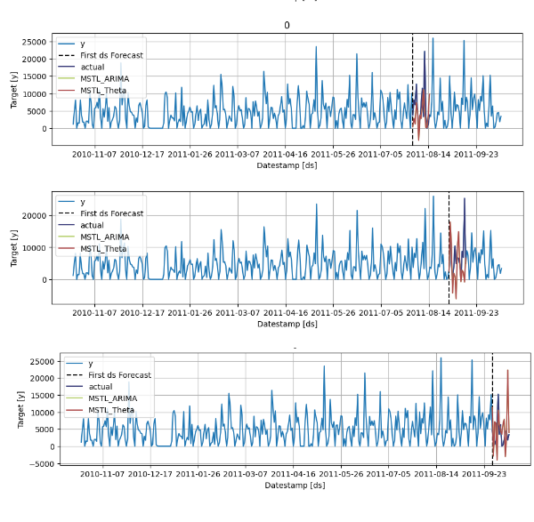
Model Section - Forecasting
Transaction counts for all segments were passed through a multiple seasonality model for a weekly and yearly seasonality trend.
3-fold cross-validation for 15 day periods.
Best performing model still had an MAE of over 40% after removing negative predictions.

Slide 11

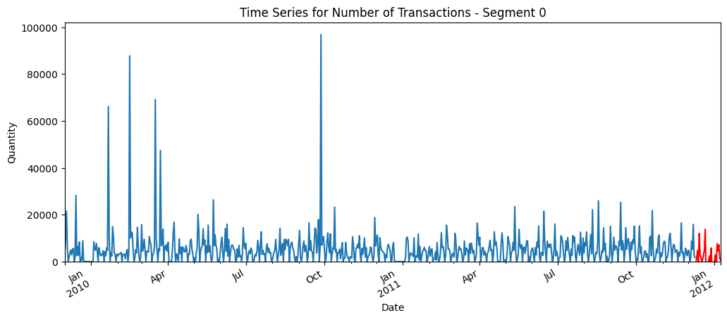
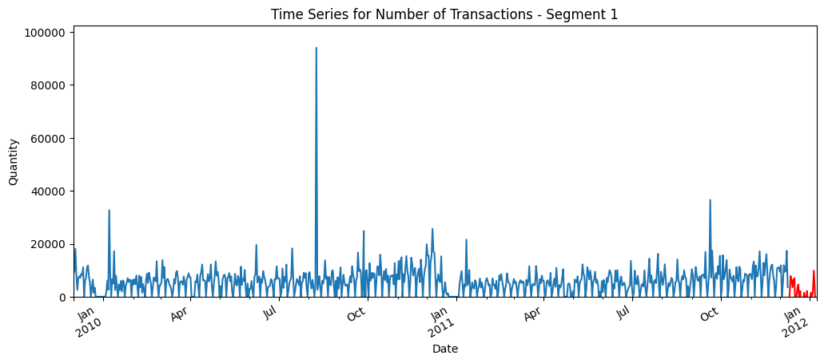
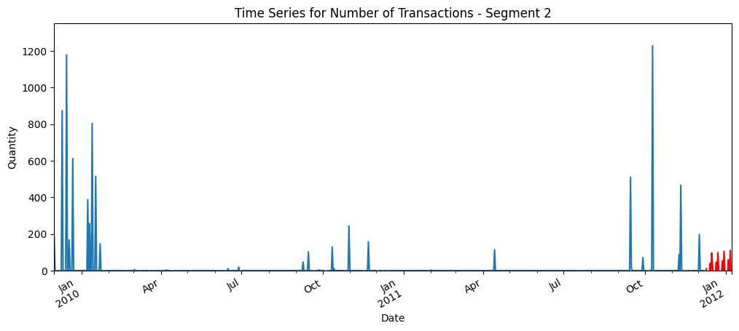
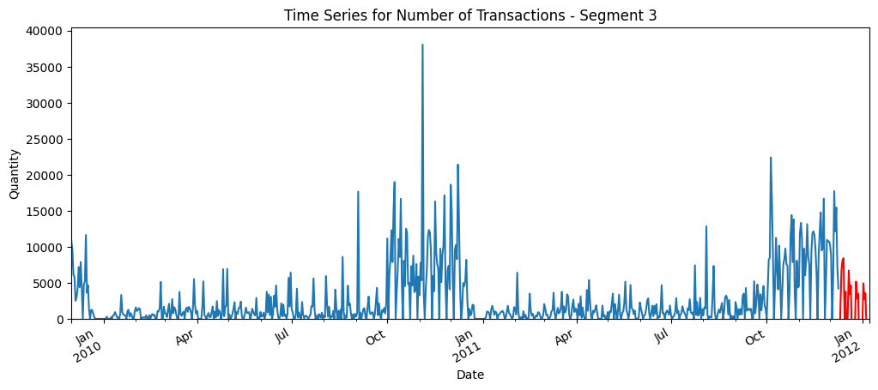
Results – Forecasts for Clusters

Slide 12

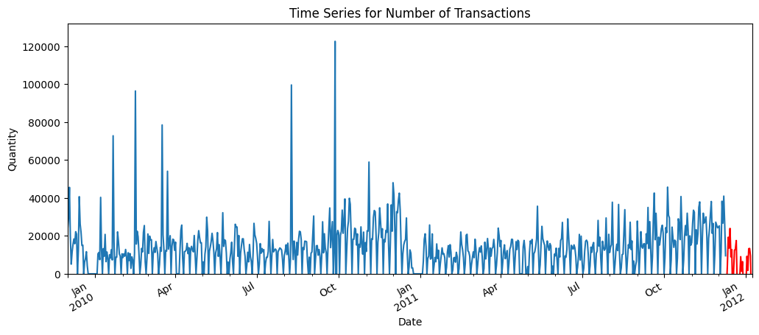
Conclusion
Room for improvement with additional tuning and better segmented data.
Segments usable for marketing initiatives.

Slide 13

Thank you

